Slide 1

01
CSC03A3 Mini Project
Team:
223133431
219024762
222057715
222046463

Slide 2

FraudGuard SA: Unmasking the Fakes
Graph-Based Document Fraud Detection

Slide 3
02
The Great ID Heist

Slide 4
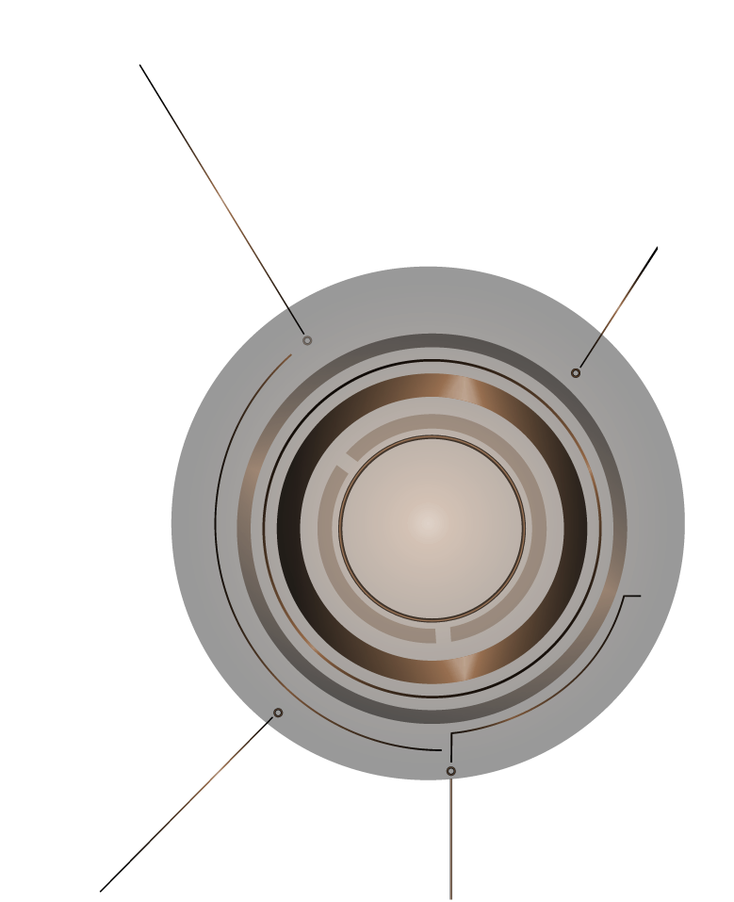
The Problem at Hand
South Africa's green ID book is the most targeted ID document in Africa, with a 34% fraud attempt rate.
Identity theft cases have surged by 400% between April 2023 and April 2024.
Victims face severe consequences: job losses, financial ruin, and legal entanglements.
Fraudsters are leveraging AI and deepfakes, with a 1,200% increase in such attacks in South Africa.

Slide 5
03
Our Clever Counterattack

Slide 6

Introducing FraudGuard SA
Utilizes OCR to extract text from ID images.
Constructs a Region Adjacency Graph (RAG) to model document layout.
Compares the RAG against a verified template using Graph Edit Distance.
Employs Dijkstra's algorithm to assess structural integrity.
Outputs a similarity score to determine authenticity.

Slide 7
04
Building the Defense

Slide 8
System Architecture
Input Module
Preprocessing
Receives scanned ID images.
Applies OCR and detects layout structures.
Graph Construction
Verification Engine
Output Module
Builds RAG representing document fields and their relationships.
Compares against template graphs and calculates similarity.
Displays results with visual indicators of authenticity.

Slide 9
05
The Brain Behind the Operation

Slide 10
Core Algorithms
Graph Edit Distance
Measures differences between the input and template graphs.
k-Nearest Neighbors (k-NN)
Classifies documents based on similarity scores.
Dijkstra's Algorithm
Ensures the logical flow and positioning of document elements.

Slide 11
06
Lights, Camera, Verification!

Slide 12
07
The Proof is in the Pudding

Slide 13
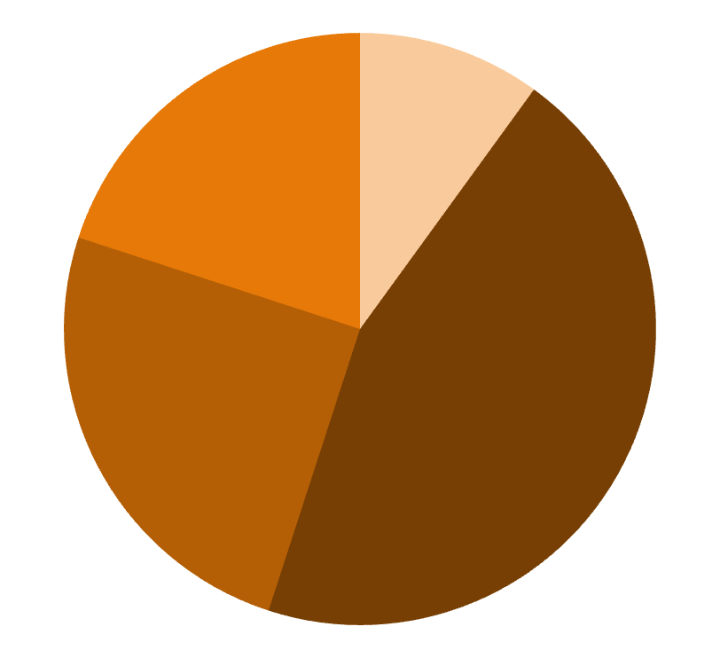
Results & Metrics
92%
2.5s
72%
Accuracy
Achieved a 92% success rate in detecting fraudulent documents.
Processing Time
Threshold
Average verification time is 2.5 seconds per document.
Documents with a similarity score below 72% are flagged for review.

Slide 14

Charting the Future

Slide 15
Next Steps
Mobile Integration
Develop a mobile app for on-the-go verification.
Batch-Processing
Enable bulk verification for organizations.
Database Linkage
Integrate with government databases for real-time validation.

Slide 16

Thanks!
Any Questions?

